Slide 1

ONESIE FUNSIE AND THE MARSH OF THE MALLOWS?
ART BIBLE
Ivy Cheng, Tassia Jaric, Shaziah Crowie

Slide 2
GAME CONCEPT
“Onesie Funsie and the Marsh of the Mallows?”
is a 2-4 player beat-em-up, party game where players attempt to collect the most gummy bears. By punching each other with their baby marshmallow fists, players force each other to drop some of their gummy bears.
First to reach ‘x’ amount wins.

Slide 3
ARTISTS, ROLES & CONTRIBUTIONS
TASK | ALLOCATED MEMBER
CONCEPT ART
Characters | Tassia
Environment | Shaziah
Collectable Items (misc.) | Ivy
ART BIBLE | Ivy, Tassia, Shaziah
MODELLING
Characters (Pan, Eli, Liz, Ham) Marshmallow | Tassia Ivy
Environment Trees, Grass Rocks, Clouds, Bush Planet | Shaziah Ivy
Other Assets (Apples, Gummy Bears, Campfire, Cookies) | Ivy, Tassia, Shaziah
TASK | ALLOCATED MEMBER
TEXTURING
Each asset textured by whoever modelled it | Ivy, Tassia, Shaziah
RIGGING (character, marshmallow) | Shaziah
SKINNING | Ivy, Tassia, Shaziah
ANIMATING (punch, running, victory/selection pose, defeat) | Ivy, Tassia
UI Art | Ivy, Shaziah

Slide 4
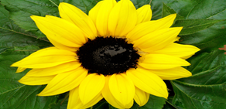
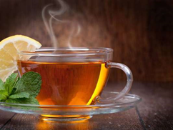
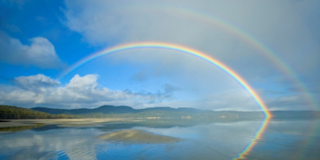

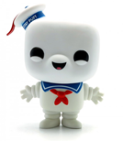
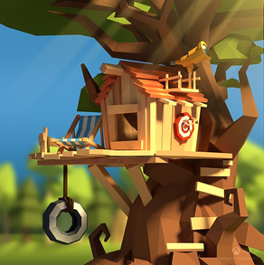
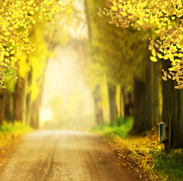
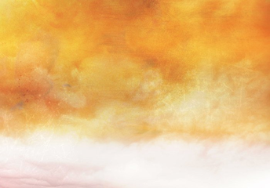
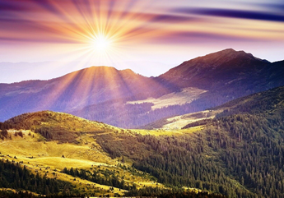
MOOD BOARD
What mood do we want?
Overall a sunny, warm, cheerful, happy environment
End game mood:
Gradual fade into grey scale

Slide 5
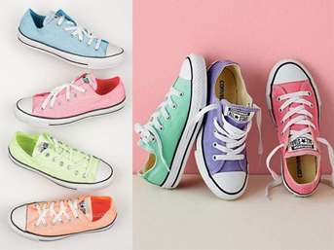
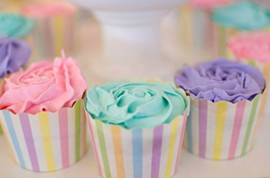
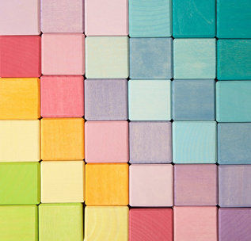
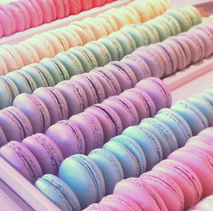
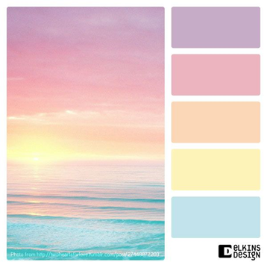
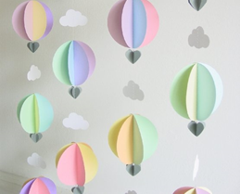
COLOUR PALETTE
Our aim is to make our game as colourful as possible. The colours will revolve around desaturated
pastel shades for the surrounding environment and more saturated colours for the characters and items.

Slide 6
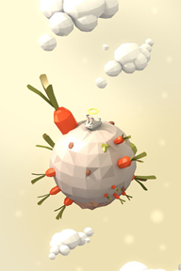
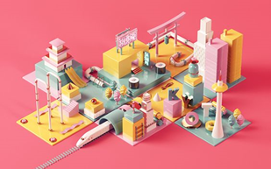
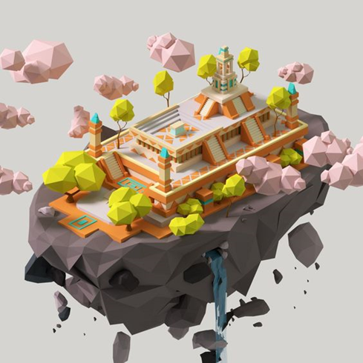
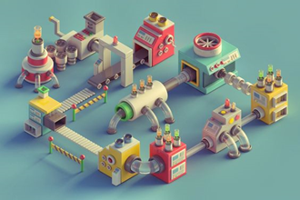
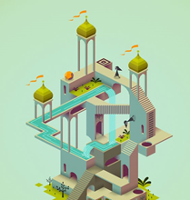
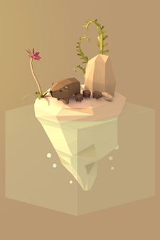
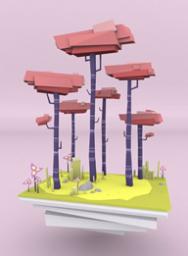
ENVIRONMENT STYLE REFERENCE
What kind of style do we want?
Stylised, lowpoly assets, hand-painted, desaturated colours
We really like their use of low-poly assets. The shadings are also mainly just flat colours which we really like as it is simplistic yet still appealing.
The desaturated colours also give off a cute vibe which is what we are aiming for.

Slide 7
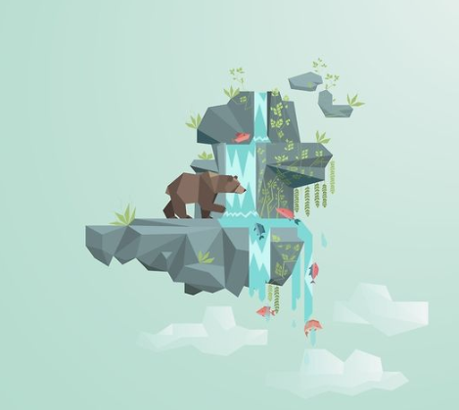
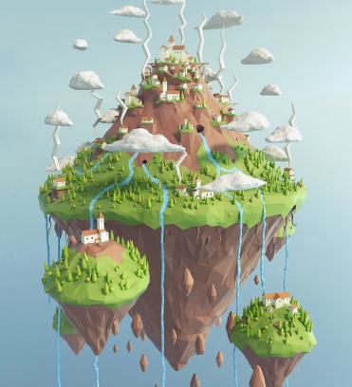
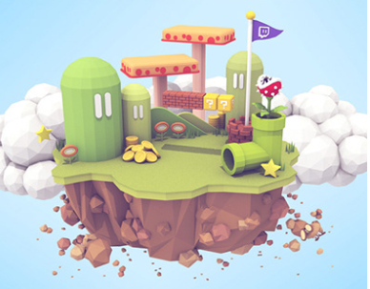
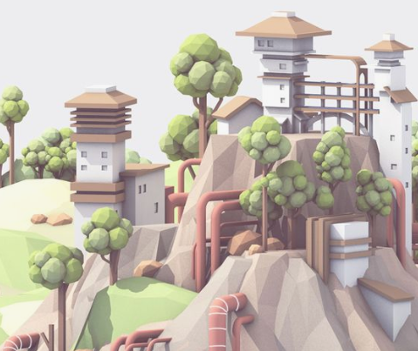
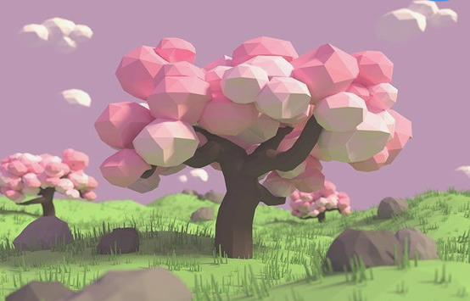
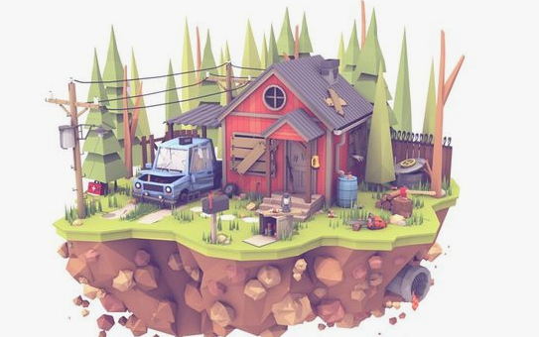
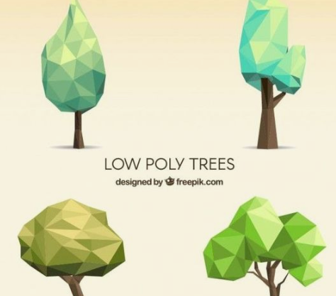
ENVIRONMENT STYLE REFERENCE
More low-poly desaturated environments we used as inspiration for our game
We really liked these low poly trees and thought this simplistic style will suit our game

Slide 8
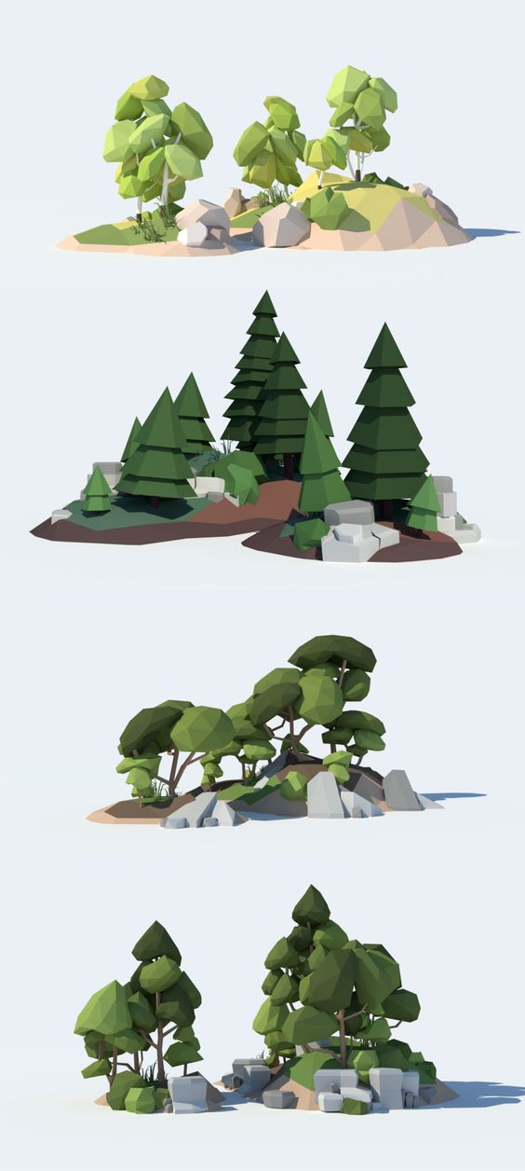
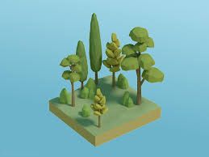
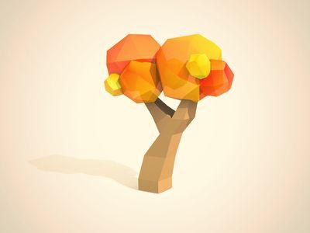
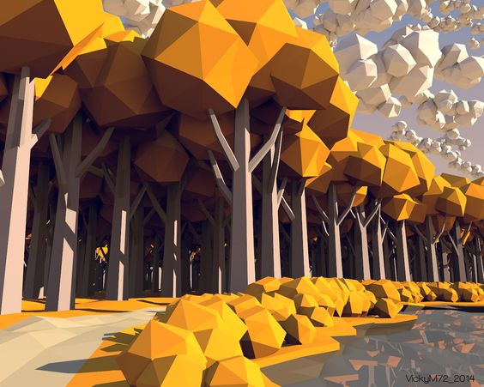
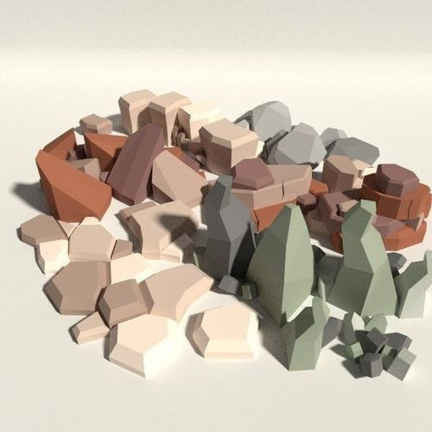
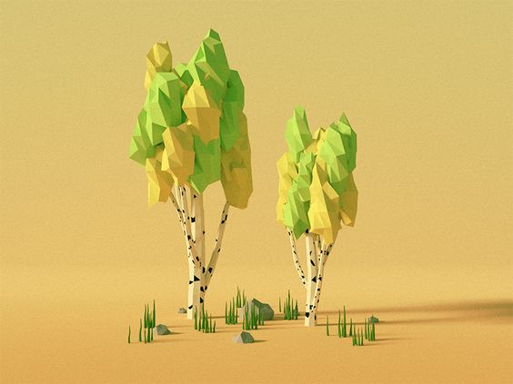
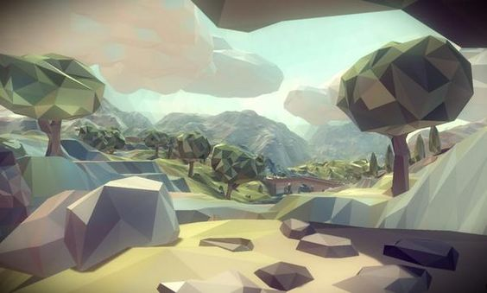
ENVIRONMENT STYLE REFERENCE
These rock references are the kind of style we are aiming for. The grey soft tones will allow the pastel colour palette to be balanced out.
We really like the style and look of the clouds and trees as it suits our simplistic and cute aspect of our game.

Slide 9
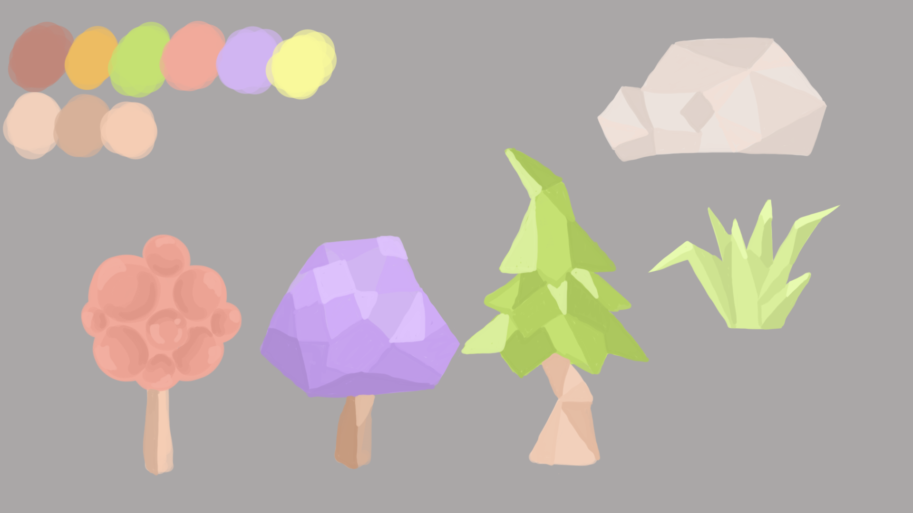
ENVIRONMENT CONCEPT ART
Concept art of what our stylised,
low poly environment will look like.
These are the main assets that will be
included in the environment.

Slide 10
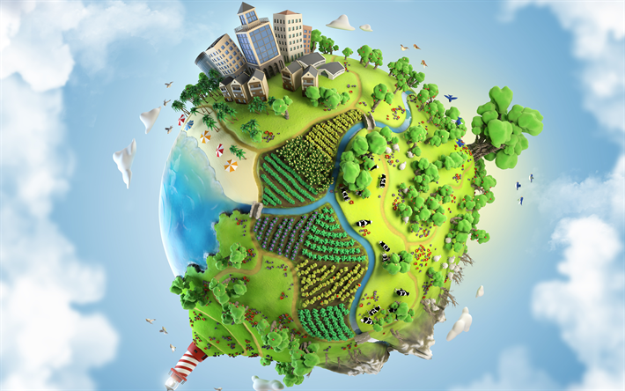
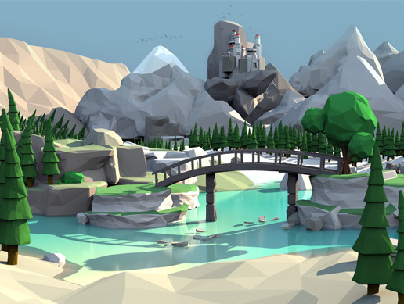
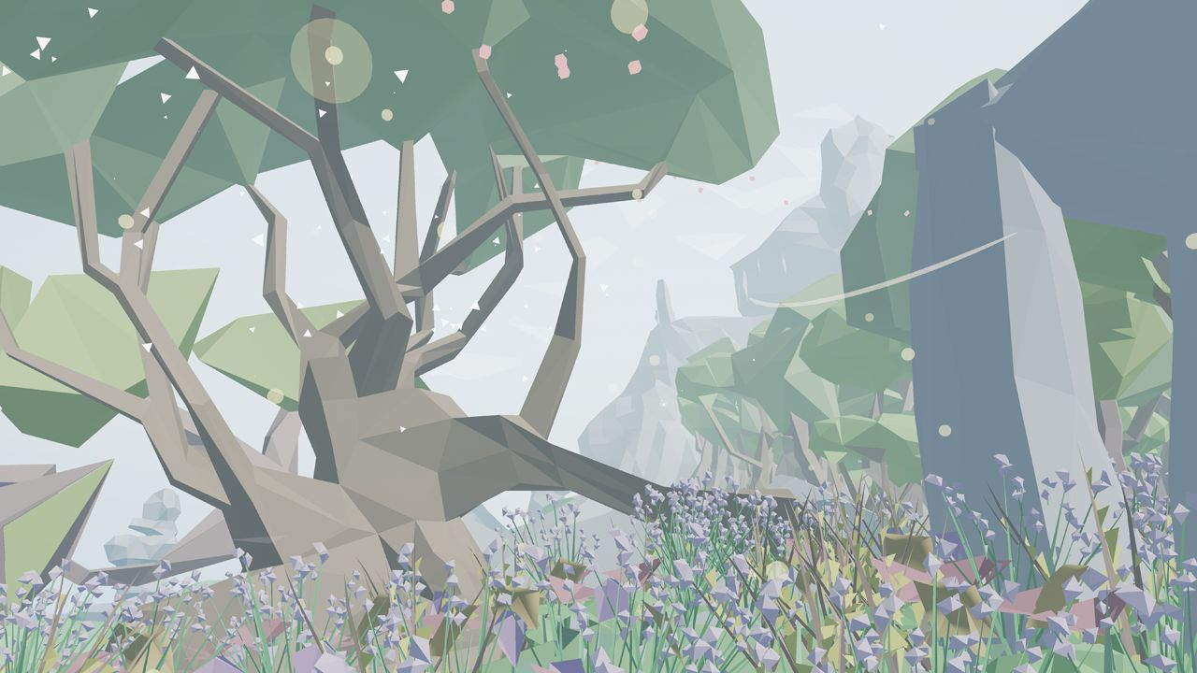
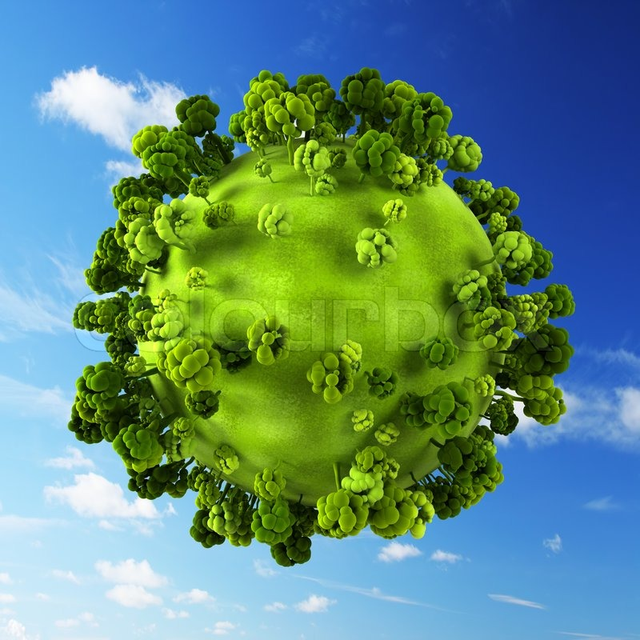
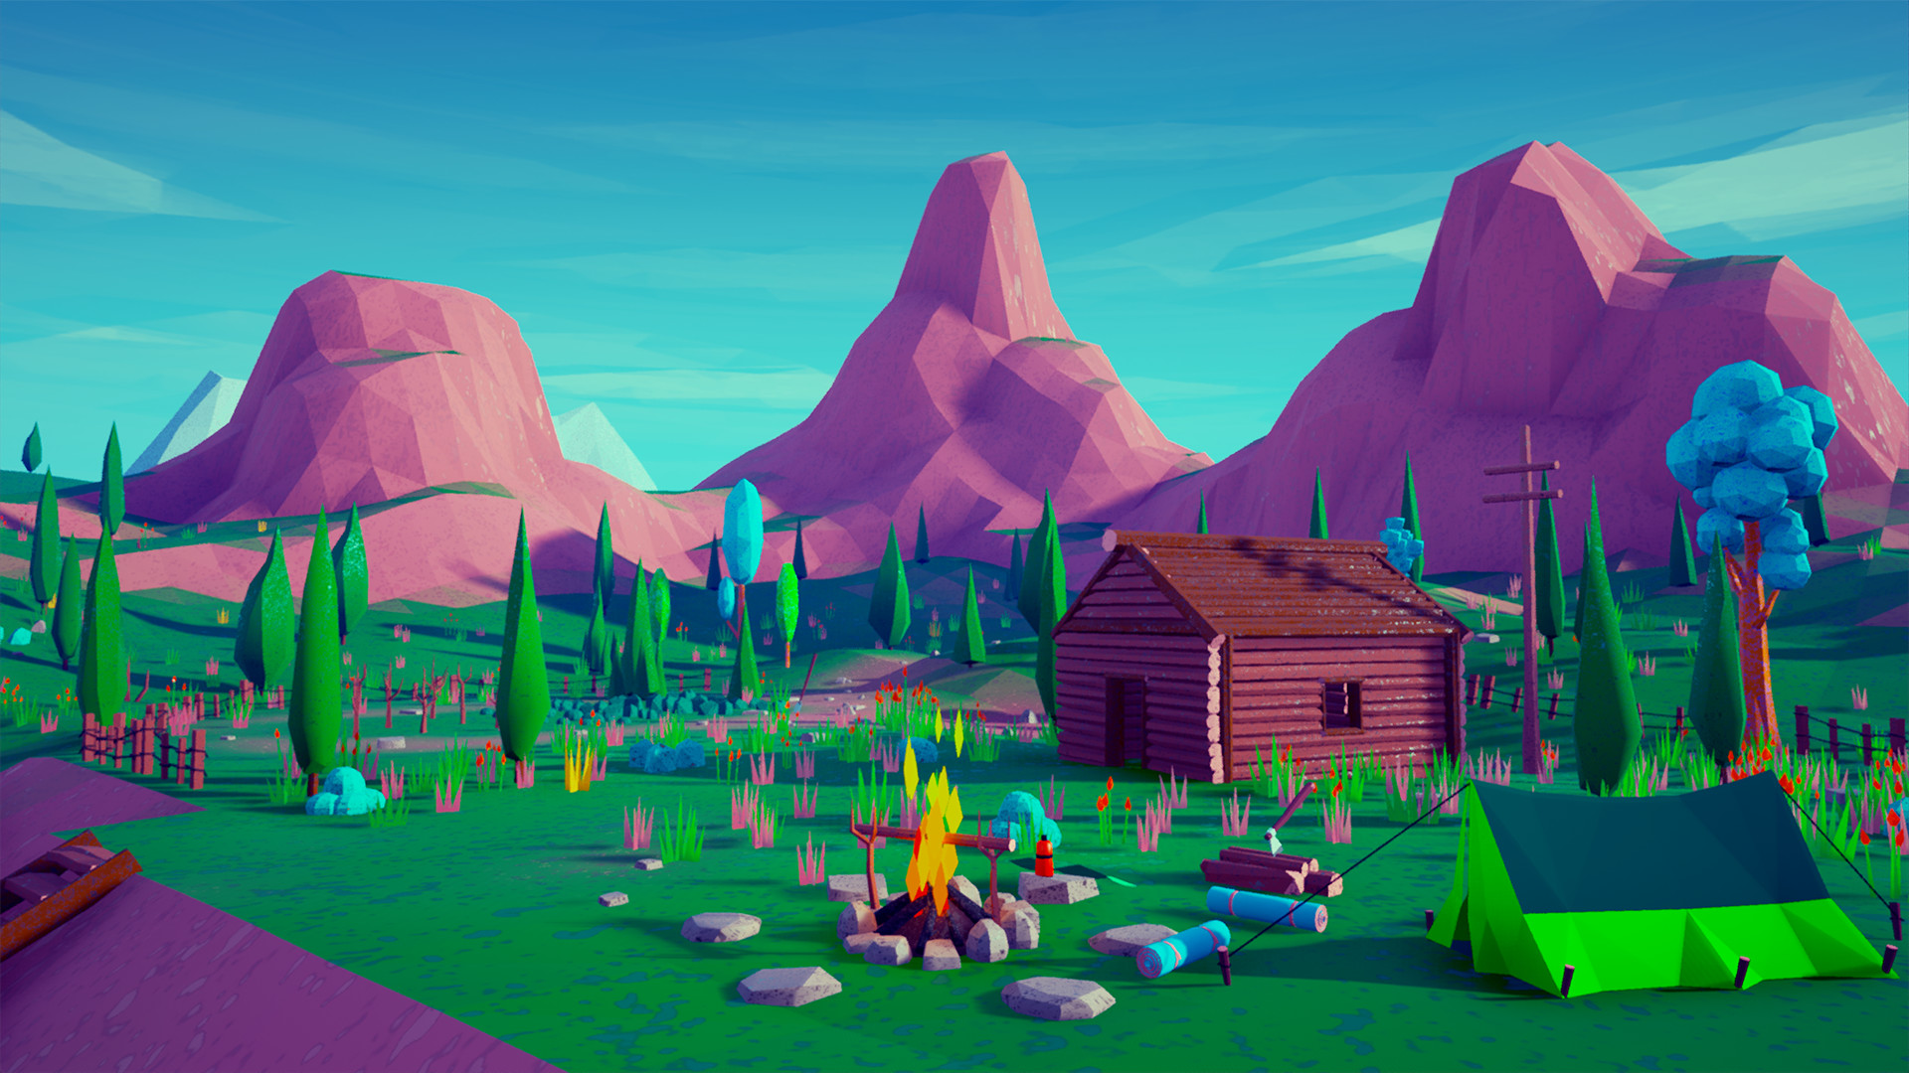
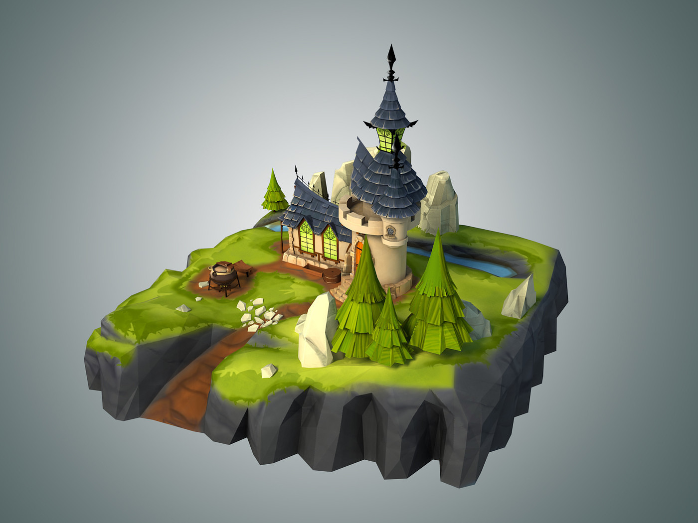
ENVIRONMENT DESIGN RESEARCH
Example of an environment on a planet. The layout and perspective is sort of what we are after.
Some low poly environment assets we will use as reference (eg. the rocks and trees)

Slide 11
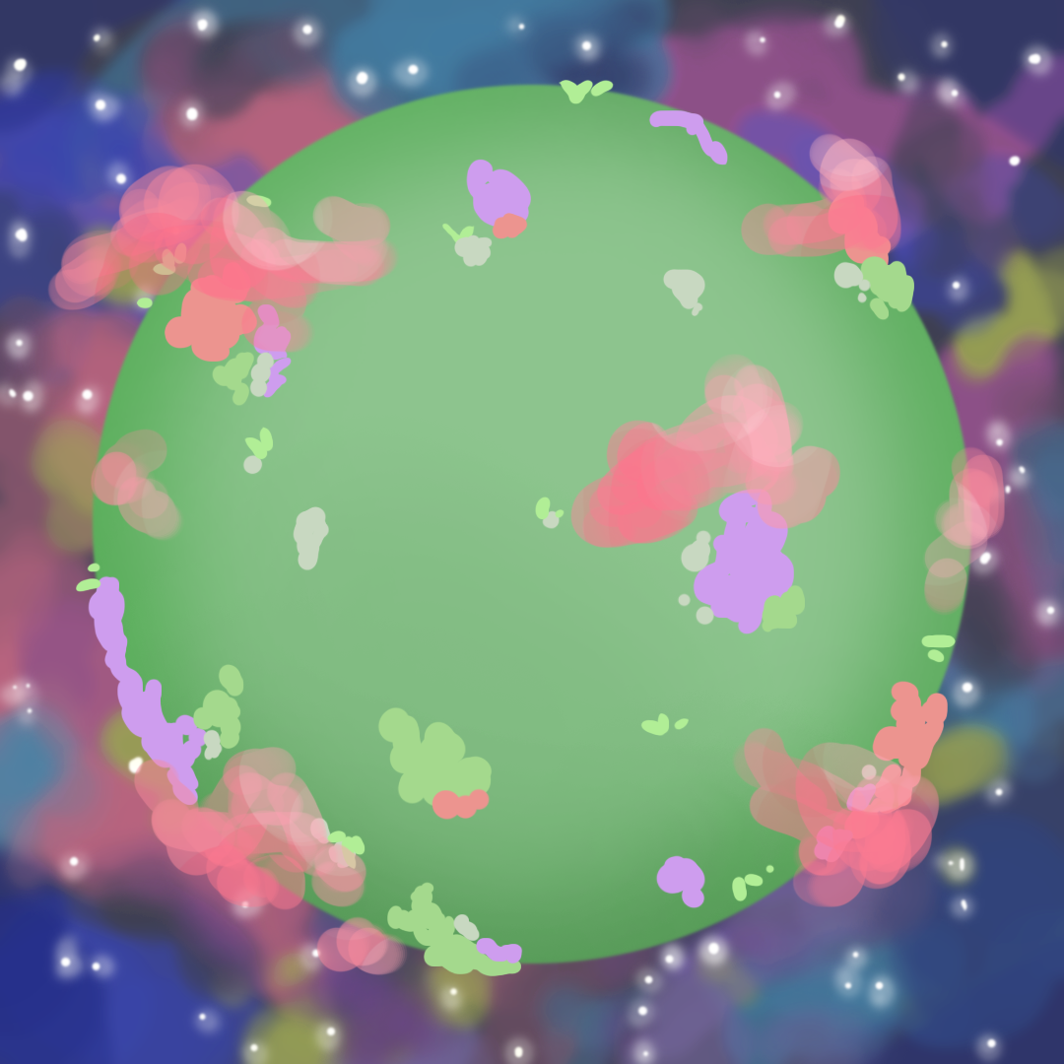
ENVIRONMENT CONCEPT ART
Here is a concept art of what our planet will look like. The colour of the planet will be green and consist of a range of environmental assets such as trees, rocks, bushes and grass, all of which will set a ground for players to interact with (eg. use them to hide).
The trees and bushes will be in slight bright pastel colours of green, purple and pink while the rocks will remain grey to balance out the colours of the planet.
The backdrop of the game will consist of blurred colours of blue, purple and pink, with some brighter spots of white to resemble stars.
This is to give players the vibe that they are in ‘space’, which revolves around our central theme of a ‘planet in space’.

Slide 12
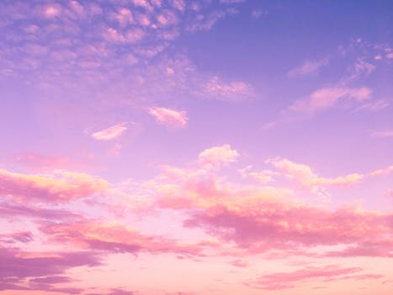

ENVIRONMENT CONCEPT ART
Instead of a starry night, we decided go with a pinkish purple sky as it gives off more
of that ‘happy’ vibe which we were aiming for.
We also decided to add in moving clouds in the foreground so that
our scene appears more ‘alive’.

Slide 13
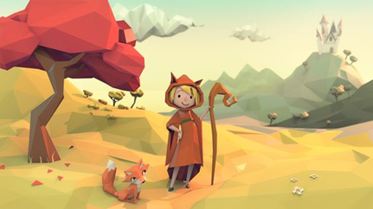
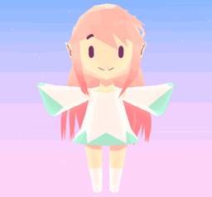
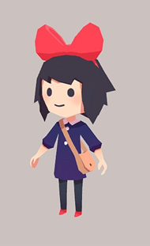
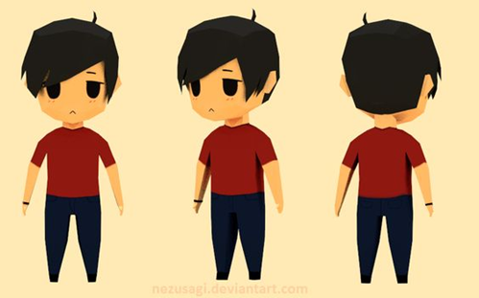
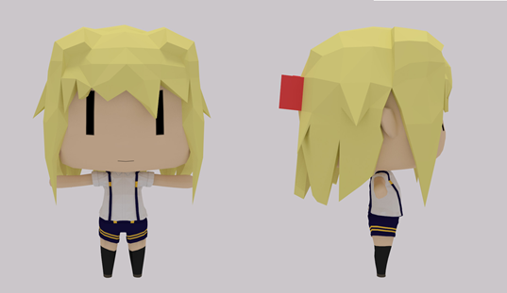
CHARACTER STYLE REFERENCE
To make our characters appealing, they will be stylized and in chibi form. The characters will also be modelled in
low poly and hand painted.
The size of the heads and gloves will also be emphasised, by making them LARGE.
After looking through references, we thought going with chibi form will be more suitable for our game.
Just like these references here, we are making our characters low poly and the textures will mainly be flat colours.

Slide 14
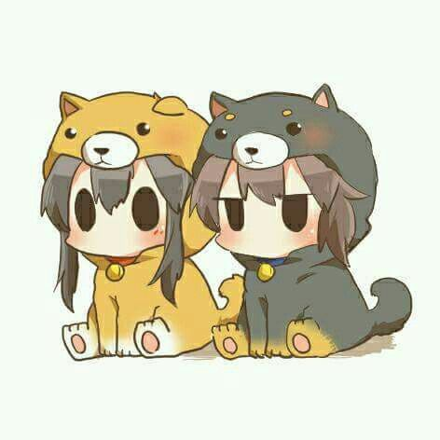








CHARACTER STYLE REFERENCE
We have decided on a chibi style, Big head and small body, for the character. They will also be wearing cute animal costumes (onesies) similar in style to these references

Slide 15







CHARACTER STYLE REFERENCE
For our game, we decided to go with a super low-poly character for all four characters while keeping a chibi style.

Slide 16





CHARACTER DESIGN RESEARCH
In order to keep to the theme, instead of animal characters, we thought of making our characters wear onesies.
We researched various designs and these onesie outfits were our main inspirations.
We also thought of designing four different animals, all of which will portray different personalities, giving variety to our players.

Slide 17

CHARACTER CONCEPT THUMBNAILS
This was our first design.
After thinking about our game again, we thought that the character may be too tall and big, especially the fact that they will be running on a planet.

Slide 18

CHARACTER CONCEPT THUMBNAILS
Instead, we thought we’d go with more of a chibi style to suit the game, emphasising on the big heads and huge marshmallow hands.
These are some of the concept art for our characters. All of them are wearing different animal onesies, while portraying different personalities.

Slide 19




CHARACTER CONCEPT THUMBNAILS
Here are a few more concept designs of our characters, all of which later became our final concepts.

Slide 20

FINAL CHARACTER CONCEPT

Slide 21

FINAL CHARACTER CONCEPT

Slide 22

FINAL CHARACTER CONCEPT

Slide 23

FINAL CHARACTER CONCEPT

Slide 24










ITEMS DESIGN RESEARCH
These are our inspirations for the collectable items.
Keeping to our theme, we collected a range of ‘cute’ and ‘sweet’ objects/items.

Slide 25






COLLECTABLE ITEMS CONCEPT ART
Marshmallows
Held by players and used as weapons to punch each other
Candies
collectables
Teddy Bear
collectables
Honey
Stuns player for ‘x’ seconds
Donuts
collectables
Mushrooms
collectables

Slide 26




COLLECTABLE ITEMS CONCEPT ART
After discussing with the group again, we decided on some power ups and finalised some items that will be more suitable for these particular power ups.
Here are the final designs with a brief description:
Campfire
When stood next to for too long = player’s marshmallows set on fire, allowing their punches to deal more damage, hence making other players lose more gummy bears than usual.
HOWEVER, setting the marshmallows on fire also causes Mama Marshmallow to strike the planet, targeting the player.
Apples
When walked upon, player will lose ‘x’ amount of gummy bears
Gummy Bears
Collectables that players
pick up throughout game
Cookies
Increases speed for ‘x’ seconds

Slide 27






SPECIAL EFFECTS REFERENCES
The Campfire and Marshmallow will have a fire effect added to it.
Using yellow and orange colours.
Power-ups and Gummy Bears will have a faint sparkle effect on them.
This will allow the items to stand out against the surrounding environment, hence attracting players’ towards them and encourage them to use them

Slide 28



MARSHMALLOW REFERENCES
In order to bring some ‘extra fun’ to our game, we thought of the marshmallows being set on fire, which ultimately led to the ‘Mama Marshmallow’ idea.

Slide 29


CHARACTER CONCEPT THUMBNAILS
Mama Marshmallow

Slide 30




ANIMATION POSE REFERENCES
Animation reference (running, punching, victory actions) will be filmed by our fellow group members and used when animating.
Punching references
Walking & running references

Slide 31



SCHEDULE MILESTONES

Slide 32
PLATFORM CONSIDERATIONS
Platform | Limitations
PC, played with controllers | Those who do not own a PC or controllers will not be able to play the game
 | The game will also need to be compatible with low end PCs with graphic cards that are good enough to run the game
 | Impact on art pipeline & process
 | Assets will all need to be modelled in low-poly (200 - 1k poly)
 | Textures will also need to have rather lower resolutions

Slide 33
NAMING CONVENTIONS
MAYA |  | ZBRUSH |  | SUBSTANCE PAINTER |  | PHOTOSHOP
Project | Projectname_v###.ma | Model | Assetname_v###.zpr Assetname_v###.ztl | Texture files | Assetname_v###.spp | Concept | Objectname_v###.psd
Assets | Assetname_mesh_v### |  |  | Exported Textures | Texturename_mapname.png | Textures | Texturemapname_v###. psd
Retopology | Assetname_LP_v### |  |  |  |  | Exported Textures | Texturename_mapname. png
Rigging | Assetname_GEO Assetname_CON Assetname_NULL Assetname_JNT
OBJ Assets | Assetname_LP/HP_v###.obj

Slide 34





SOFTWARES
Used for:
• modelling hard surface assets
•retopology
•animation
Used for:
•modelling characters
Used for:
• concepting
• texturing
Used for:
• hand-painting textures
Used for:
• game engine

